Slide 1
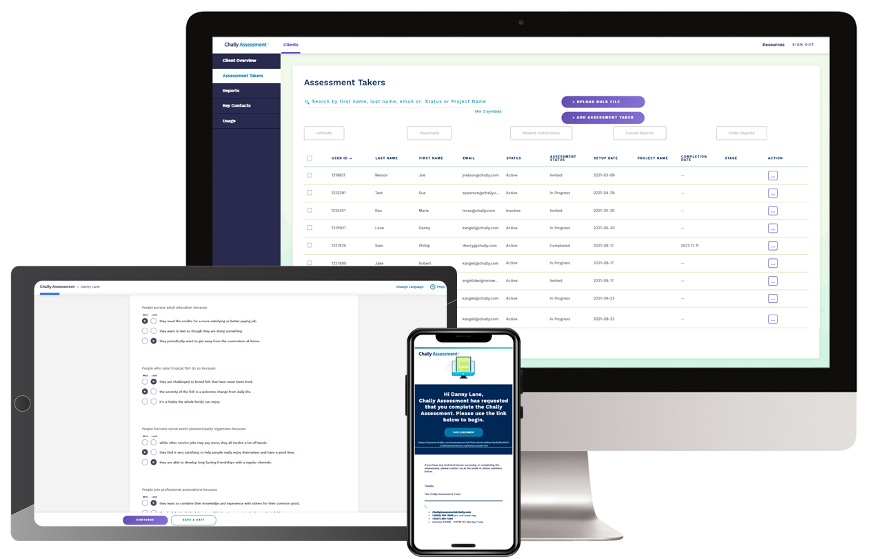
Chally Intro Deck
Introduction to the Chally Assessment

Slide 2
Why use the Predictive Talent Assessment
1
Determine if the sales team that got you where you are today is the team you need to succeed in the future.
Use objective evidence to make the right sales hiring decisions.
Unlock your sales team’s potential with insights and tools for onboarding, coaching, and personal development planning.
Retain your top talent when making tough decisions.
2
3
4
Business Trigger Events
Problems that we Solve
Merger or acquisition
New go-to-market strategy that requires different approach and sales skills
Changing market requirements and/or competitive landscape
Hiring to Rapidly Scale the Business
Continual shortfall of sales goals
High unwanted turnover rate
Difficulty identifying and attracting the right candidates (critical roles go unfilled)
Lack of role clarity
Wrong people in wrong roles (lack of people with capabilities needed to execute strategy)
Lack of effective and consistent talent processes (recruiting, on boarding, sales enablement)

Slide 3
Why use the Predictive Engagement Assessment
New Research
30%
The traits and characteristics of the individual employee either enhance or constrain the employee’s engagement level, as well as their ability to engender engagement in others
Each candidate gets assigned to one of three buckets –
“High Propensity to Engage”
Predisposed to put extra effort into work
Derive intrinsic value from a job well done
Feel a personal connection to the job irrespective of work conditions
“Moderate Propensity to Engage”
Likely to respond positively to employee engagement activities
Will become more engaged as the organization invests in engagement strategies
“Low Propensity to Engage”
Less likely to be engaged, regardless of organizational culture or work conditions
More likely to destabilize work groups and impede work unit productivity
of employee engagement is driven by factors other than organizational culture
Highly engaged workforces have experience on average
10% increase in customer loyalty
18% higher sales productivity
Clear Answers
22% greater profitability
28% less workplace theft
43% less turnover in low-turnover orgs.
64% fewer workplace accidents
81% less absenteeism
Source: https://www.gallup.com/workplace/285674/improve-employee-engagement-workplace.aspx

Slide 4
Chally Value & Difference
We let decades of rich data do the talking
Our Efficient,
Effective Role Analysis Process
The Predictive Power of Our Assessment
We Specialize in Understanding what
it takes to be a Top Employee
Ability to Integrate via API to your HR Systems

Slide 5
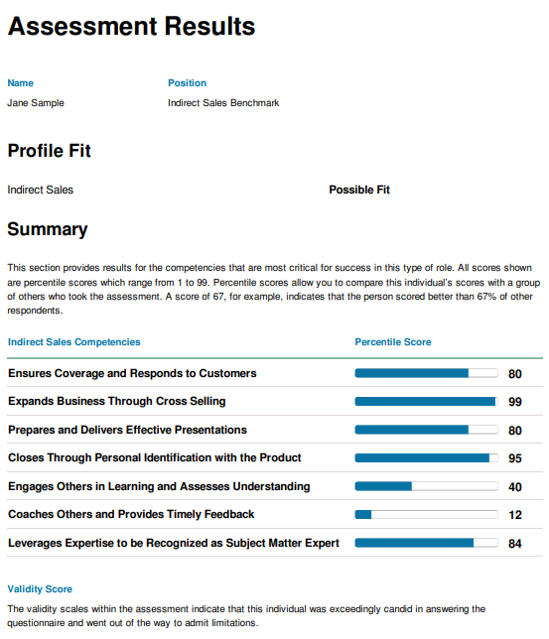
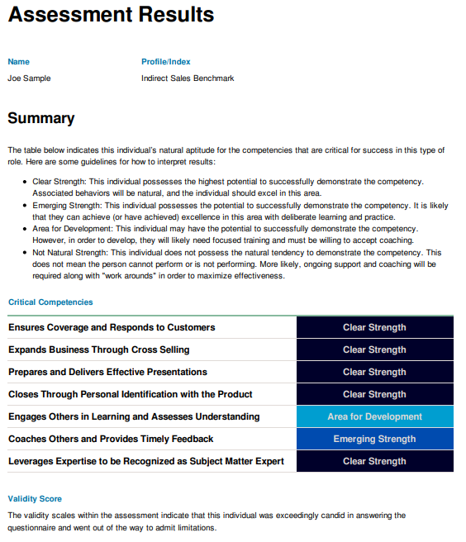
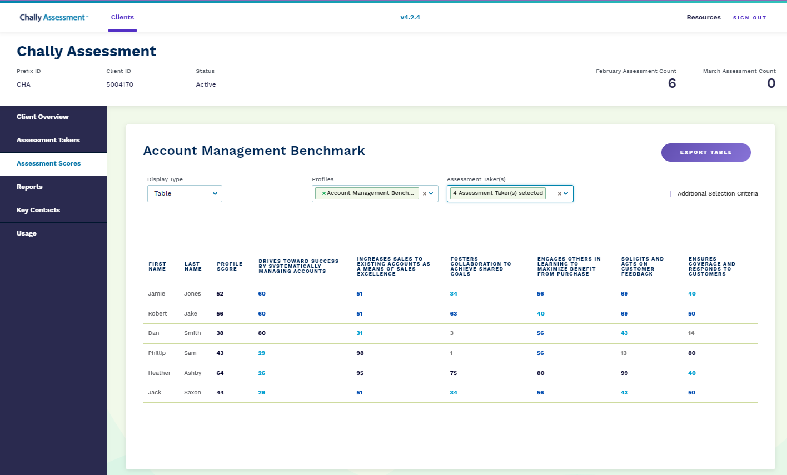
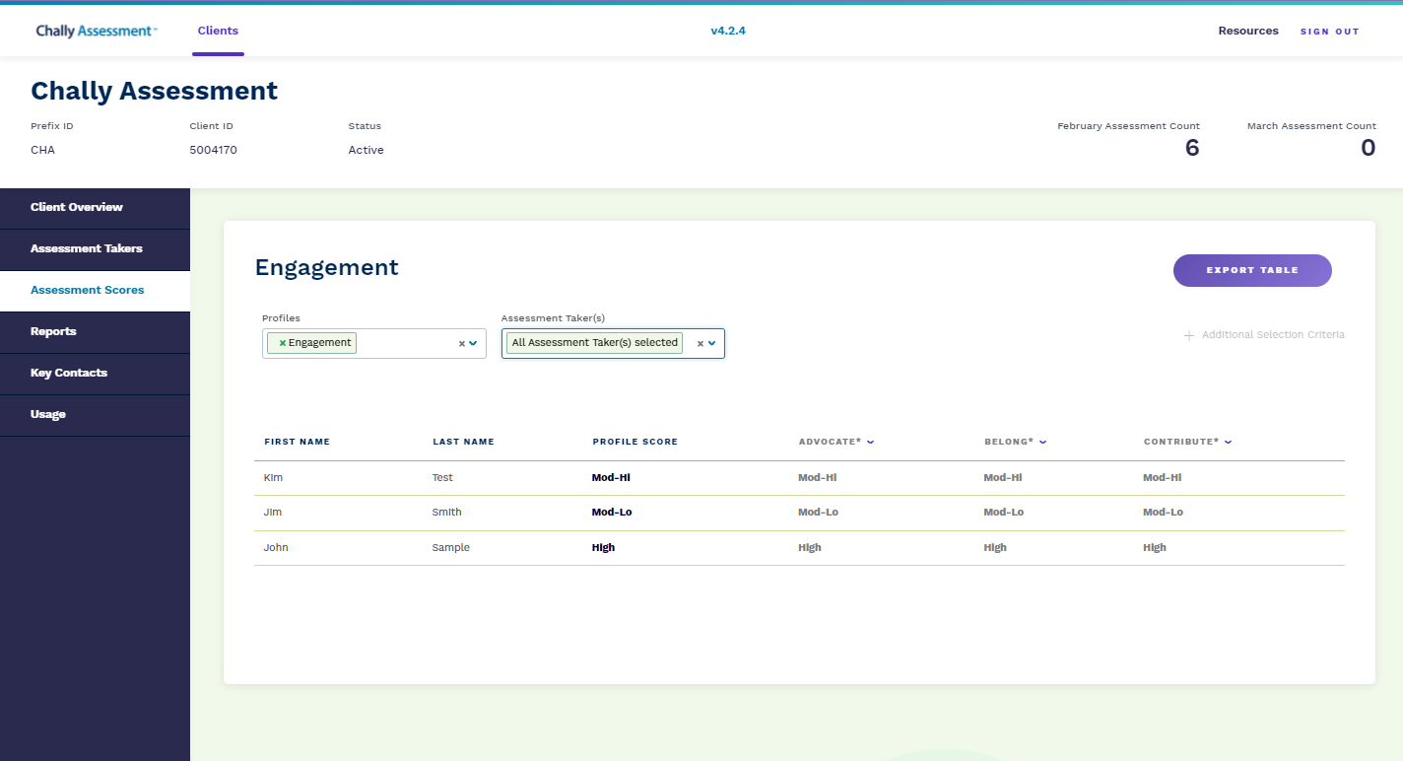
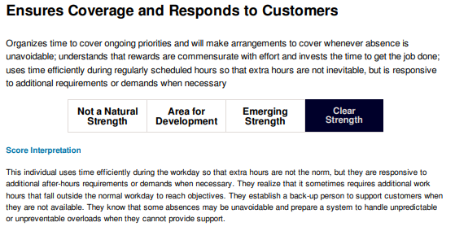
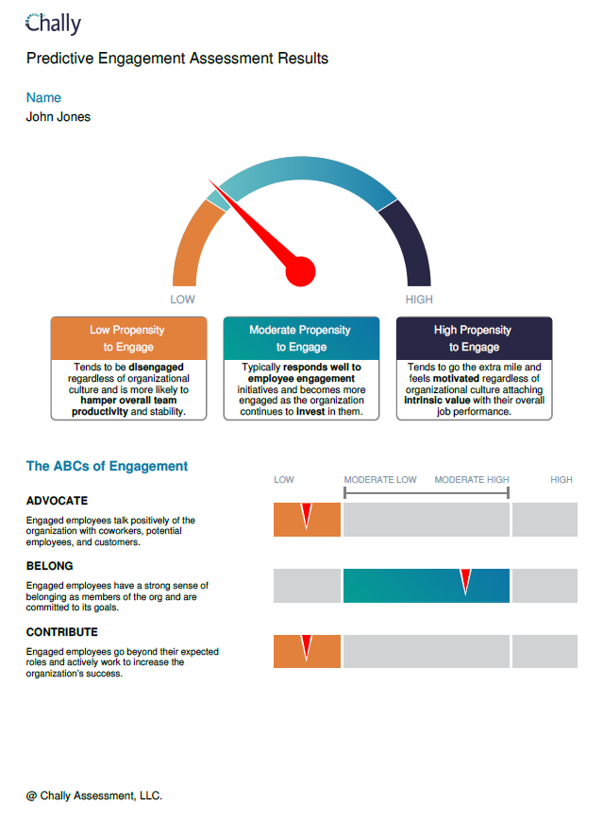
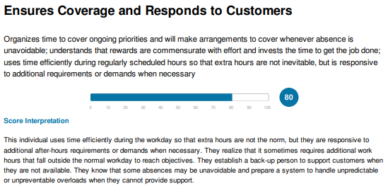
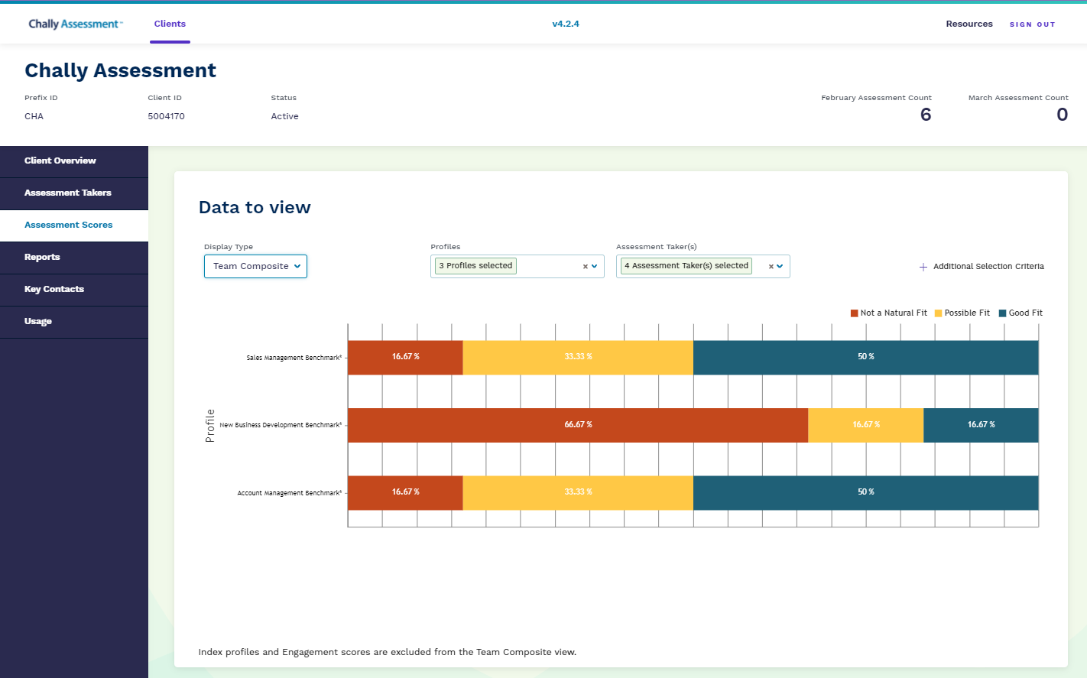
Success can be predicted Best-in-class solutions to hire, develop, and manage talent
Candidate Assessment
Development & Coaching
Team Capacity
Propensity for Engagement
Selection reports allow you to know at a glance if a candidate is a good fit for your role.
Development reports allow salespeople and their managers to have conversations that maximize engagement and performance.
The Results Dashboard provides you with data on your team’s competencies and overall sales capacity.
Engagement Assessment gives you the power to predict a candidate’s propensity to engage before hiring them, thus reducing the cost of bad hires.
Chally Assessment™: Based on 45+ years of Research. Backed by Science.

Slide 6
Why Chally?
Accurately predict capacity for job success
Put candidates in the right roles
Retain engaged and skilled employees
Grow customer satisfaction and revenue
We are differentiated by the richness of our data and scientific rigor behind our talent assessments
400+
validation studies
7,300
organizations served
45+
years or research
1M+
assessment respondents
135
competencies cataloged

Slide 7
Thank you!
ABOUT US:
Founded in 1973, Chally has evolved from a research firm to an industry-leading talent assessment software provider, offering greater flexibility to our customers while maintaining a scientific, data-backed approach to everything we do. For nearly five decades, companies large and small have relied on Chally to help them find the right talent, unlock their potential, and make informed, evidence-based talent management decisions.
For more information, contact us at info@chally.com

