Slide 1
Chally Assessment

Slide 2
CSO Insights - 2018 Sales Talent Study
Talent is a nearly universal challenge for sales organizations, with only 16% of sales leaders saying they are confident that they have the talent they need to succeed in the future.
Sales organizations are struggling with who to hire, how to find them and how to develop and support them.
Sales organizations confident in their talent are significantly more successful than their peers with acknowledged talent gaps:
  Higher percentages of salespeople making or exceeding goal (63.5% vs 41.2%)
  Higher win rates of forecasted deals (54.0% vs. 42.1%)

Slide 3
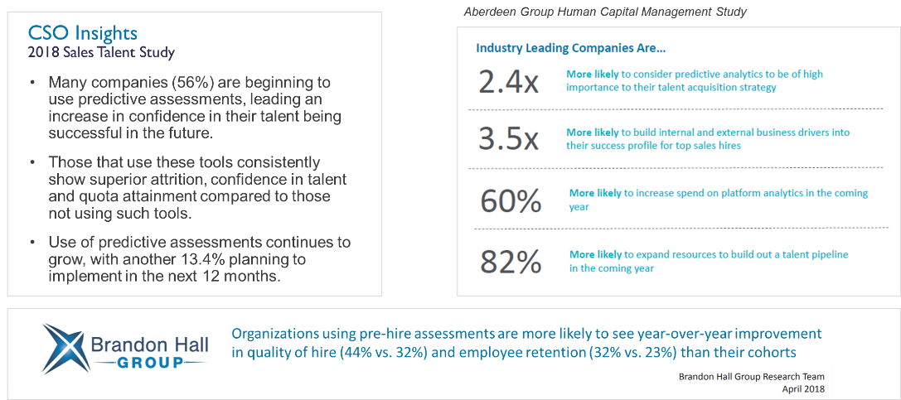
Hiring Top Sales Talent:
What Leading Companies Do To Ensure Success

Slide 4

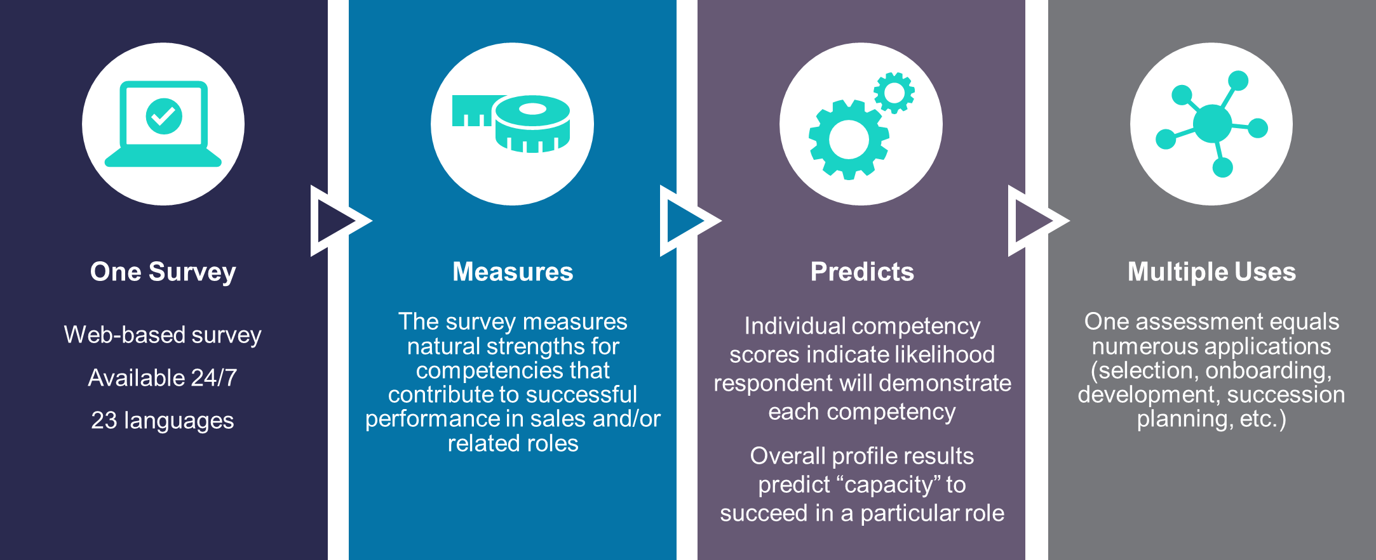
Notes:
Respondents spend 45 minutes answering approximately 270 questions; we collect roughly 850 points of data and predict the capacity of a person, team or organization on approximately 140 validated competencies.
Measures the respondent’s behaviors, skills, interests, values, attributes, motives and traits (collectively known as competencies) that contribute to successful performance in sales and/or related roles.
The overall score on a particular profile indicates the capacity/potential for success in that role and each individual score on a competency measures how likely the person has the ability to exhibit the desired behavior.
And the last box, we always say that there is one door in and multiple doors out. This means that there is one assessment and everyone who takes that assessment, whether it is a candidate applying for a job or the VP of Sales, answers the same questions. One of the greatest things about our assessment is that it has a ton of applications from using the results for selection, to onboarding, to continuous development, and there are many different types of reports that can be generated from the system.

Slide 5
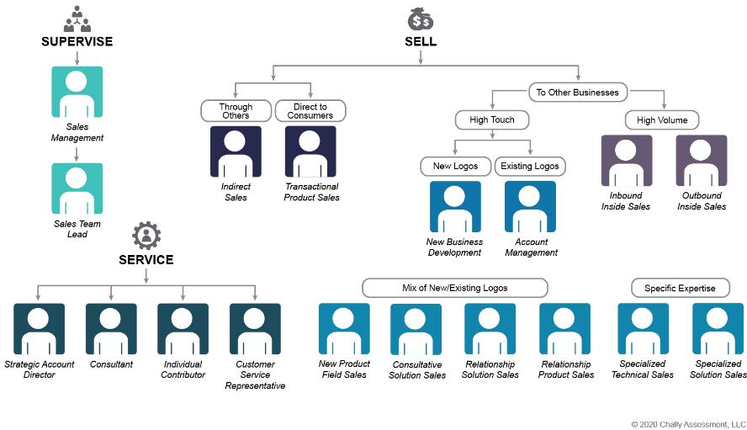
Chally Assessment™ Signature Profiles Benchmark Library
Notes:
Each Benchmark Profile contains the competencies that are statistically common to top performers and lacking in poorer performers. Thus, people who score well in these skills are more naturally matched to the job requirements. People who are not well matched yet are strongly motivated to succeed can find an alternate approach to get the job done based on their skill set. They will require tools and personally meaningful rewards to mimic the output of those who are more closely matched.

Slide 6
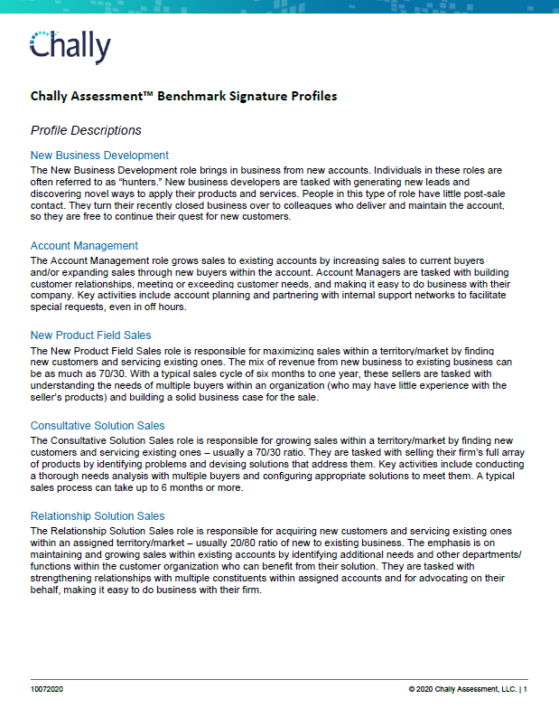
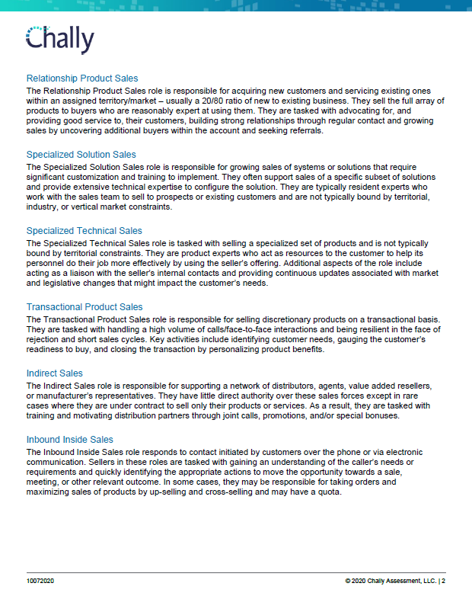
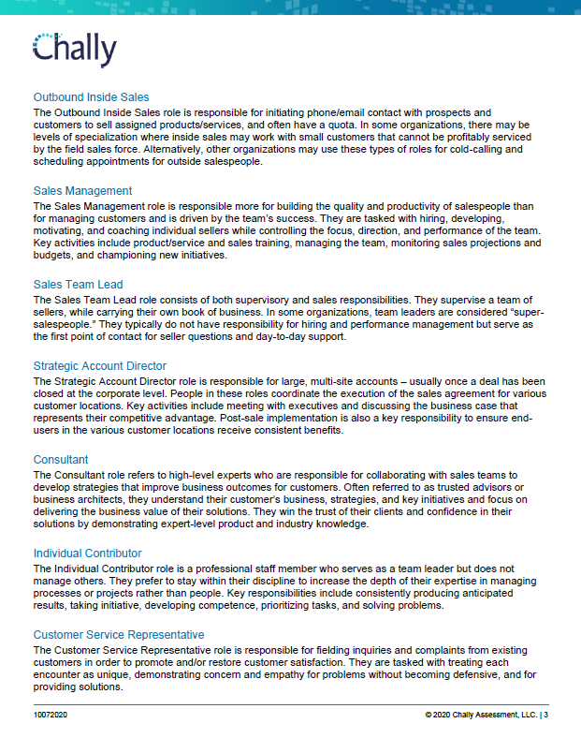

Slide 7
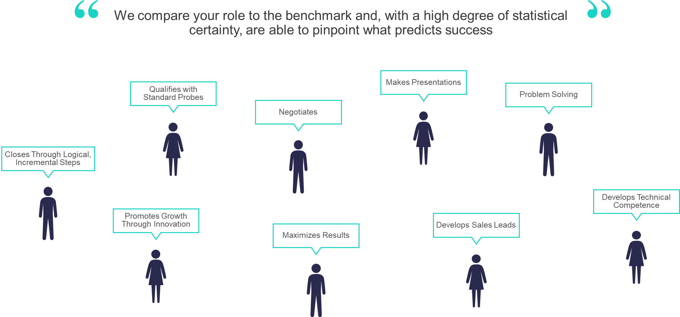
What Predicts Sales Success?

Slide 8
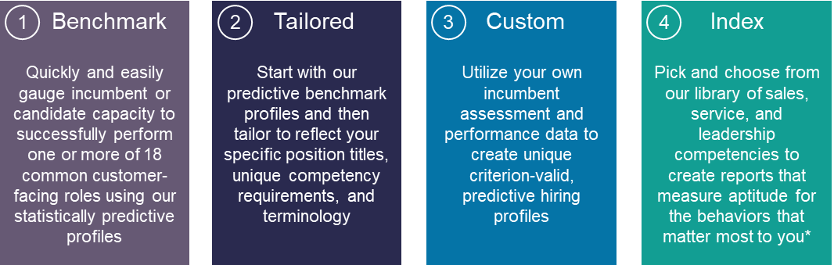
Four Profile Types Offer You the Ultimate Flexibility
Notes:
* Index option provides insight into natural aptitude and likelihood respondent will demonstrate behaviors but is not valid for predicting capacity for, or success in, a given role.

Slide 9
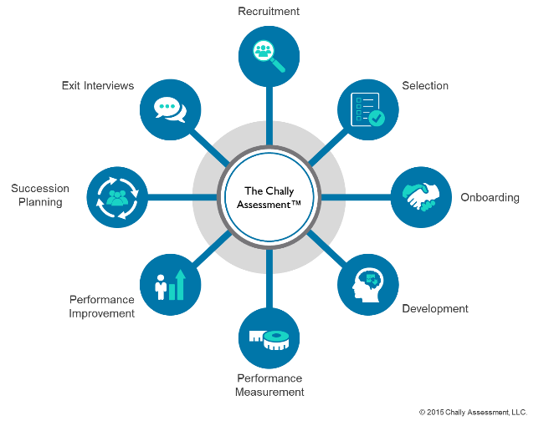
Turning Insight into Action Across the Employee Lifecycle
Notes:
We are able to use that data not only for selection, but to support decisions across the entire employee lifecycle.

Slide 10
Sample Deliverables

Slide 11
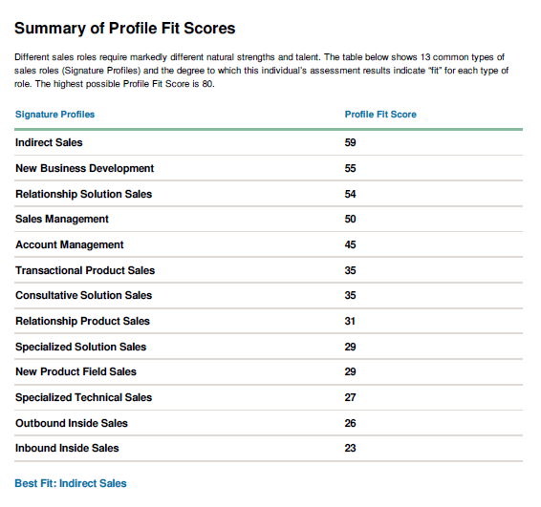
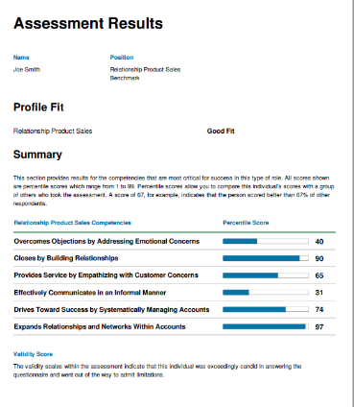
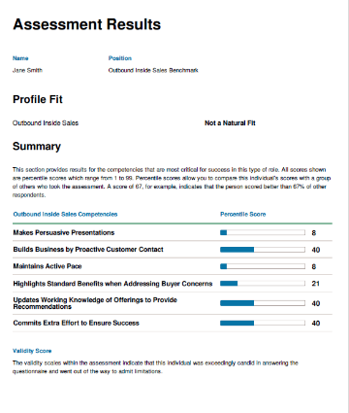
Predicting Fit for Specific Sales Roles

Slide 12
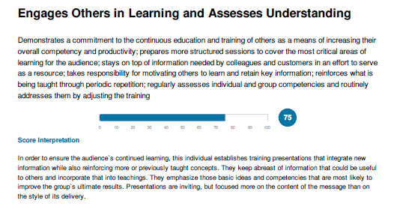
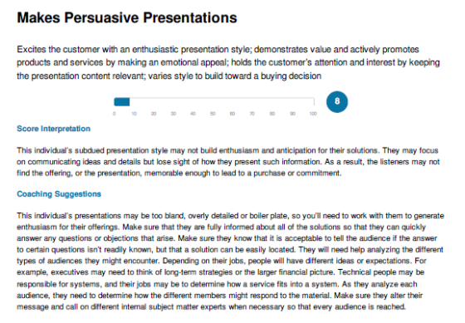
Detailed Scoring for Each Competency

Slide 13
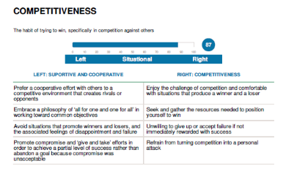
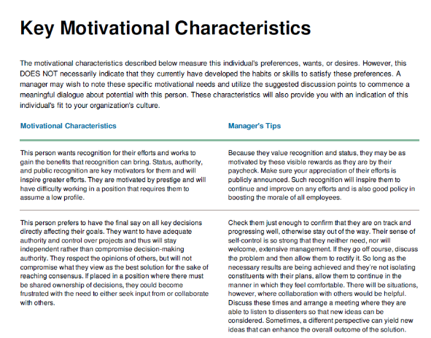
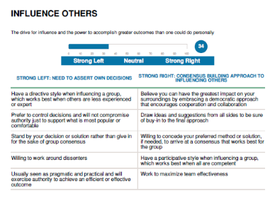
Unlocking Key Motivations

Slide 14
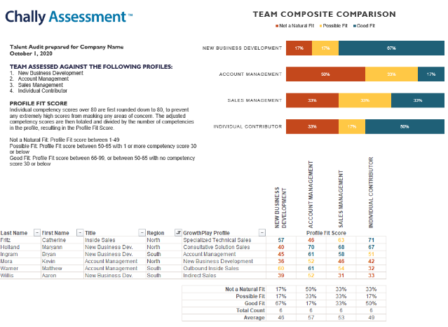
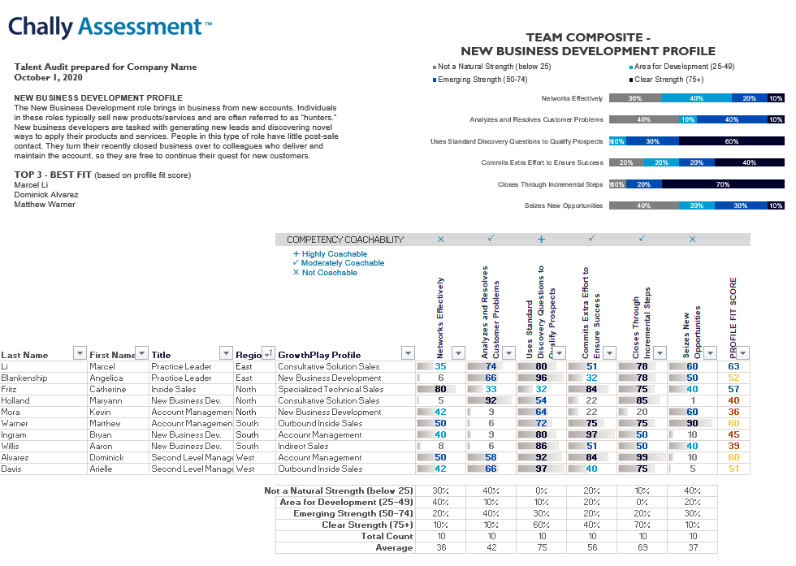
Sample Team Reports

Slide 15
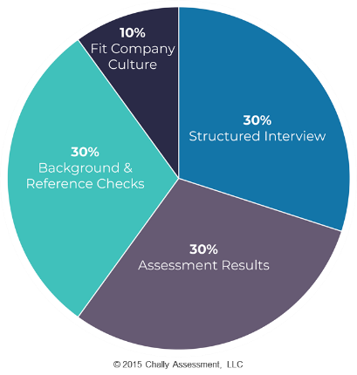
#NOPERFECTION
PERFECTION does not exist!
Assessment Results are Just One Piece of the Hiring Decisions!

Slide 16
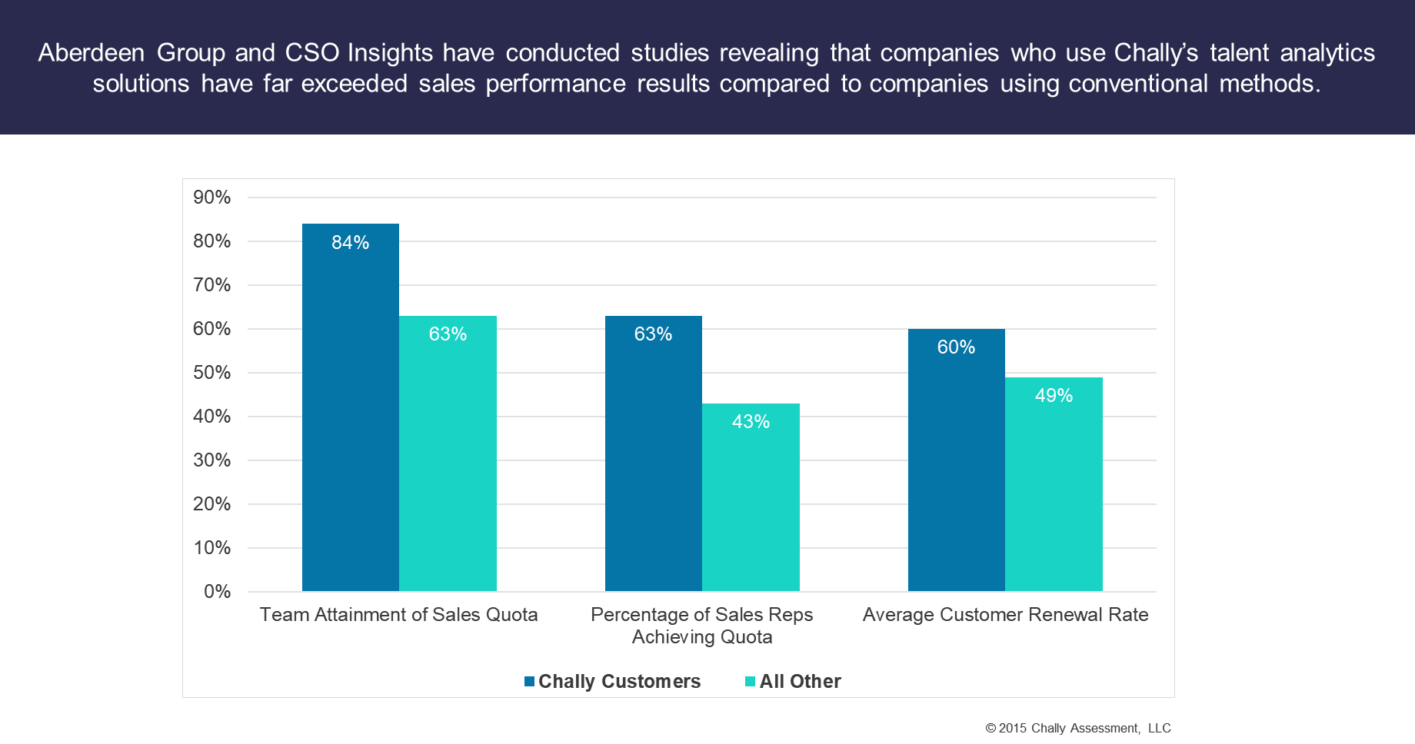
Independent Research Firms Confirm Value of the Chally Assessment
Notes:
Suggested Script:
Finding the right people for the job and placing them in roles where they will succeed is critical to the health of any organization. Chally’s talent solutions help our clients take the guess work out of talent selection and skill development. Independent research consistently demonstrates that our clients realize improvements in that what matters most to their bottom line.

